Slide 1
Idea Book Formatting:
Provide a full heading each entry (top left) that includes:
Full name
Assigning Teacher’s Name
Course
Date
Create a header that shows your last name and page number (top right)
Insert a text box to the right of your heading that includes the prompt. You may abbreviate prompts down to 1-2 sentences, but not down to phrases.
Double space all entries
DON’T skip additional lines between paragraphs
If the prompt calls for a formal business letter, alter your formatting to business letter rules
DO indent paragraphs using the tab key (not the space bar)

Slide 2
Formatting/Proofreading Reminders
DO skip a line between the title (which should be original and creative) and your response.
Only use “I” if you’re telling a personal story from your past (and do that rarely, with purpose). Remove all phrases like “I believe,” “I think,” “I feel,” “In my opinion.” The word “we” is a form of 1st person – use it very rarely, if at all.
Combine sentences using correct punctuation:
Semicolons connect two independent clauses; colons introduce key phrases or lists and mean “that is.”
Example: There’s one thing I really LOVE about sophomore year: Idea Books!
If you researched any information, use parenthetical documentation within the piece AND include a works cited entry on a separate page following each Idea Book entry. A copy/pasted website address will not be accepted.

Slide 3
Sections of the Binder
At the beginning of each collection (representing a full set of five entries), include a Table of Contents that lists your title, the assigning course, and a page number.
Behind your final IB entries, include a tab that says “drafts,” and include your earlier versions. These will likely include revision/proofreading marks from writing lessons/peer revisions conducted in class. If your teacher stamps drafts, include that version in the binder.

Slide 4
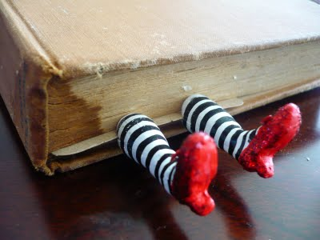
Say Farewell To…
“a lot” – too pedestrian, too vague, used too often!
Rhetorical questions at the beginning of an Idea Book entry (Do you really think they’re working? Have you ever been intrigued by a questioning opening?)
2nd person/ “you” (You should see the example above if you want to know why your journal is annoying your readers.)
“Well,….” “Now, ….” Unless you’re
writing about a “well” that you’re
digging “now,” these words are
weak transition phrases.
Referring directly to the prompt (“I
disagree because...,” “The prompt asked us to…,” “The article said,” “this quote.”)

Slide 5
Revision Reminders
Spend more time on introductions (grabbing the reader’s attention and drawing them further into your piece) and conclusions (re-stating the thesis and driving the point home).
Try to hook ideas from the end of one paragraph to the beginning of the next to form stronger transitions.

